Slide 1
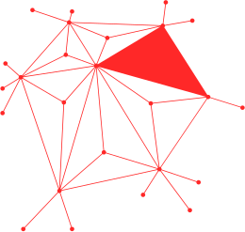

AFRICA HACKON NYAMAFEST
HARDWARE HACKING: Rubber Ducky & ZeroTrace
cyb3rloud

Slide 2
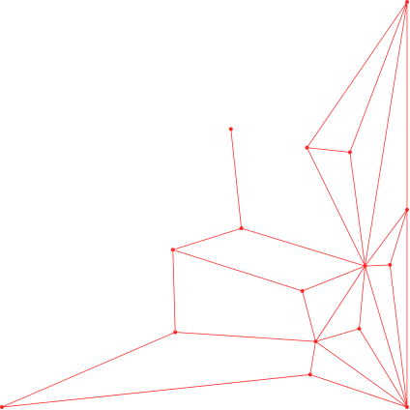
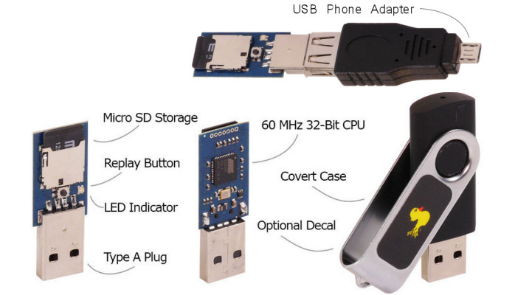
WHAT IS RUBBER DUCKY?
A USB device that looks like a normal flash drive but acts as a keyboard (HID).
Created by Hak5 for penetration testing and automation.
Executes pre-programmed keystroke injection scripts written in DuckyScript.
Can type commands at machine speed, faster than a human.
Commonly used for ethical hacking, security awareness demos, and automation tasks like repetitive admin tasks

Slide 3
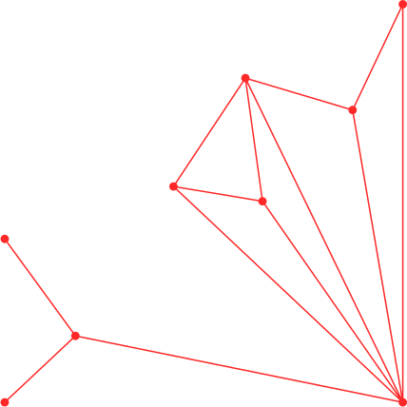
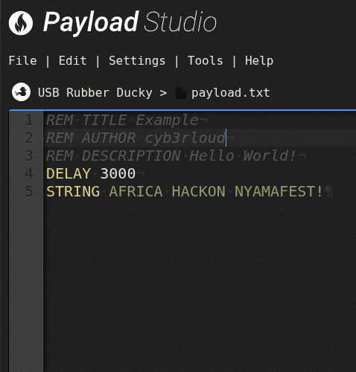
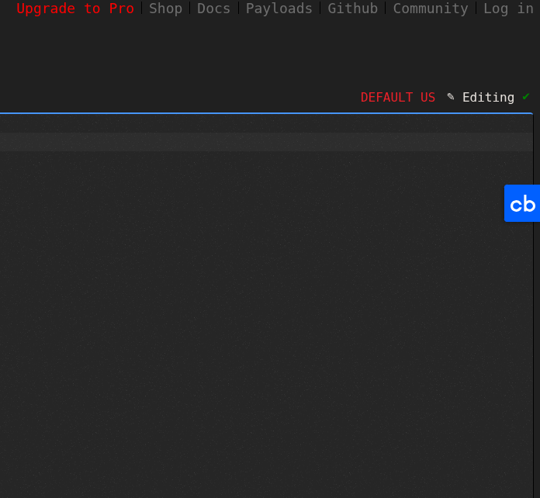
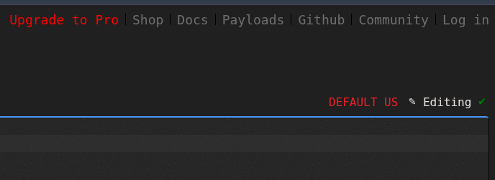
HOW IT WORKS
HID emulation: the Duck identifies to the OS as a keyboard (Human Interface Device).
Authoring: scripts are written in DuckyScript (line-oriented commands like STRING, ENTER, DELAY, GUI).
Compilation: DuckyScript is compiled into a binary file called inject.bin which lives on the microSD root.
Mount & run: the Duck enumerates as a keyboard and replays the keystrokes at machine speed.
java -jar duckencode.jar -i <input_script.txt> -o <path/to/inject.bin>

Slide 4

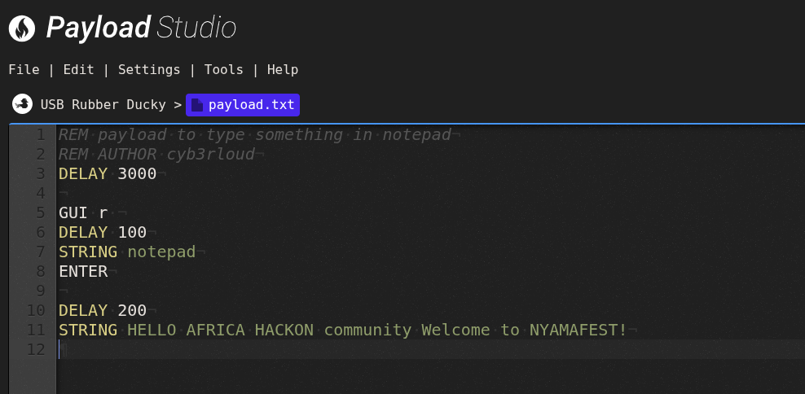

HACK AWAY
Simple Message
Not Malicious, I Promise!
Opens Run Dialog
Launches Notepad
Waits Briefly
Types in the message

Slide 5
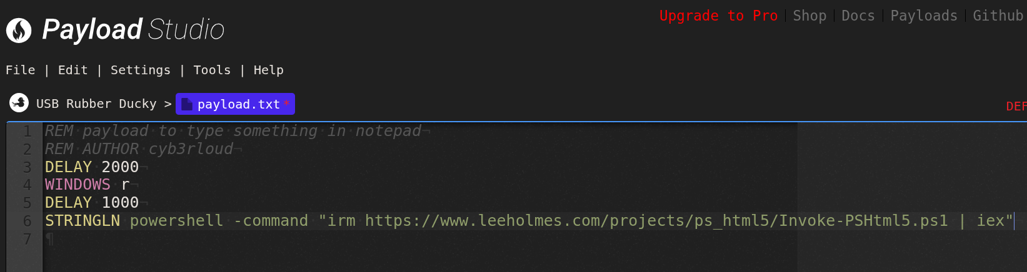
2. Rickroll
STRINGLN <PowerShell fetch & execute> - types a PowerShell command that would fetch code from the network and execute it. We will not run or demonstrate that.

Slide 6
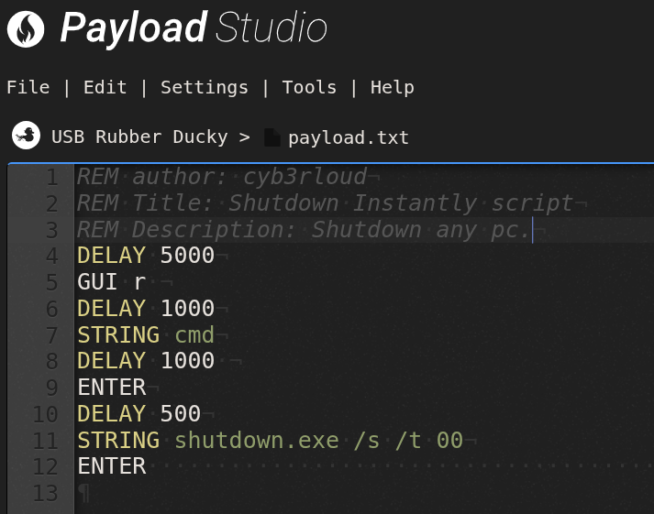
3. Shutdown
STRING shutdown.exe /s /t 00 — types a command that tells Windows to shutdown immediately:
shutdown.exe — the built-in Windows shutdown utility.
/s — shut the system down.
/t 00 — set the timeout to 0 seconds (immediate).
ENTER — presses Enter to execute the shutdown command.

Slide 7
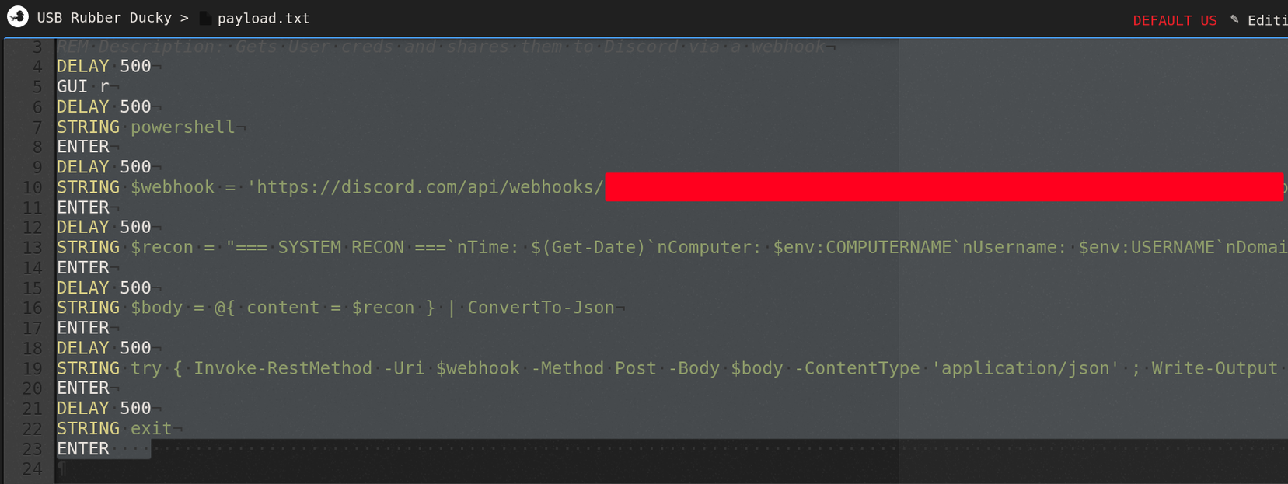
4. Credential Harvesting
Key Features:
System Information Collection: The script retrieves and compiles essential system details such as the current date and time, computer name, username, domain, and network configuration using the ipconfig command.
Discord Integration: It utilizes Discord webhooks to send the collected data directly to a specified Discord channel, ensuring real-time updates and notifications.
JSON Formatting: The data is formatted into JSON, making it easy to parse and display in Discord.
Error Handling: The script includes error handling to manage potential issues during the execution, ensuring robustness and reliability.

Slide 8
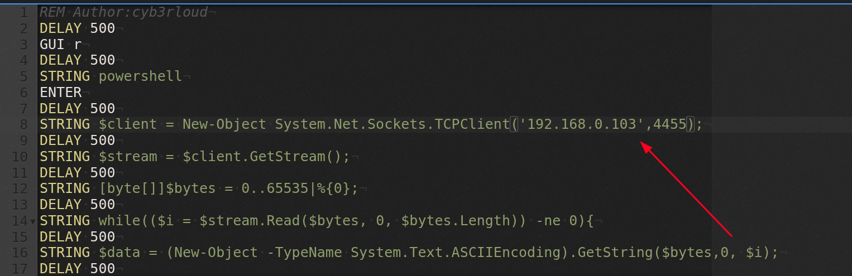
5. Admin Reverse Shell
It’s when the victim computer initiates a connection back to the attacker, giving the attacker command-line control.
Open PowerShell: The script starts by opening PowerShell.
Create TCP Client: It creates a new TCP client that connects to the specified IP address and port.
Get Stream: It retrieves the network stream from the TCP client.
While Loop: The script enters a while loop that reads data from the stream, executes the received data as a PowerShell command, and sends the output back to the attacker's machine
Persistence: For a more persistent reverse shell, consider adding the script to the target's startup programs or scheduling it with Task Scheduler.
Solution to AV Detections: Did you notice we turned off the AV?
ReverseDuckyPolymorph
One of the biggest problems when publishing payloads, exploits, POCs, etc., is static detection. If X hundred or thousand people use your script, it's more than burned. A ReverseDuckyPolymorph fights static detection. Every time your Ducky uses the payload, the variables change and therefore are harder to pinpoint.
https://github.com/hak5/usbrubberducky-payloads/tree/master/payloads/library/remote_access/ReverseDuckyPolymorph

Slide 9
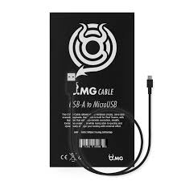
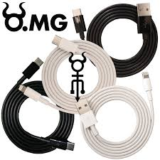

OMG
Connects to an Access Point or the IP address given in the default route
The Web Interface provides an in-built Hak5 Payload Studio
Has a different memory location; the boot script stores the script that runs when you plug in the OMG cable.

Slide 10
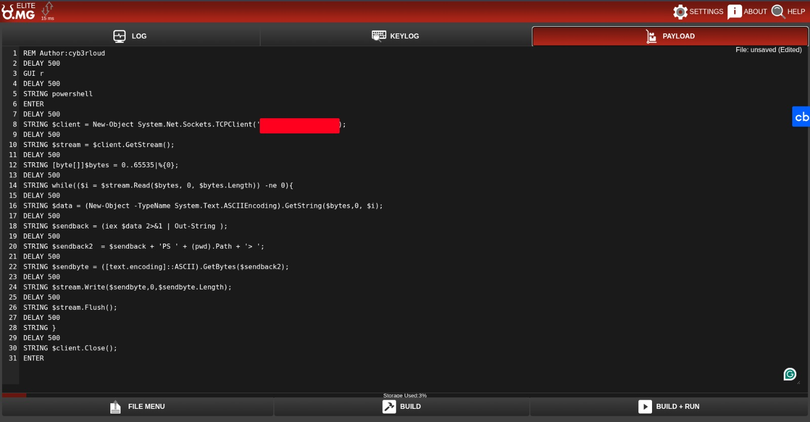
OMG CABLE

Slide 11
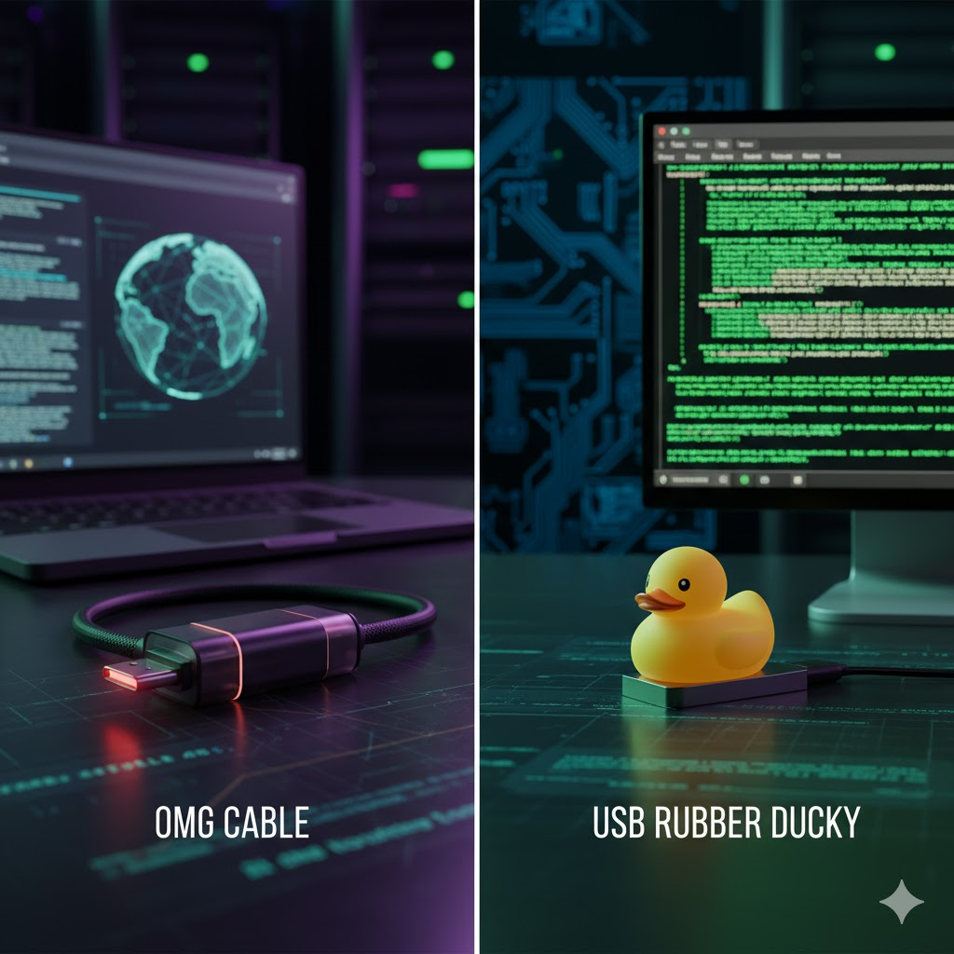
OMG > Rubber Ducky ?
Well, it depends!
Every OMG Cable creates its own local Wi-Fi Access Point (AP).
The AP can be password-protected and configured for stealth or client mode.
Operators connect via web interface or REST API to send payloads.
Payloads can be stored, managed, and triggered remotely.
Range: roughly 10–30 meters depending on environment.

Slide 12



AFRICA HACKON NYAMAFEST
HARDWARE HACKING: Rubber Ducky & ZeroTrace
cyberloud
cyb3rloud@proton.me
cyb3rloud.medium.com

